Slide 1
Module 3
Classification
‹#›

Slide 2
Classification vs. Prediction
Classification
A process of finding a model that describes and distinguishes the data classes.
predicts categorical class labels (discrete or nominal)
Typical applications
Credit approval
Target marketing
Medical diagnosis
Fraud detection
‹#›
Notes:
‹#›

Slide 3
Classification vs. Prediction
Classification
A process of finding a model that describes and distinguishes the data classes.
Predicts categorical class labels (discrete or nominal)
‹#›
Notes:
‹#›

Slide 4
Classification vs. Prediction
Prediction
Models continuous-valued functions, i.e., predicts unknown or missing values
Regression analysis is a statistical methodology that is most often used for numeric prediction.
Classification and numeric prediction are the two major types of prediction problems.
‹#›
Notes:
‹#›

Slide 5
Classification—A Two-Step Process (Learning step+Classification step)
In the first step, we build a classification model by learning from training dataset — Supervised Learning
In the second step, we determine if the model’s accuracy is acceptable, and if so, we use the model to classify new data.
‹#›

Slide 6
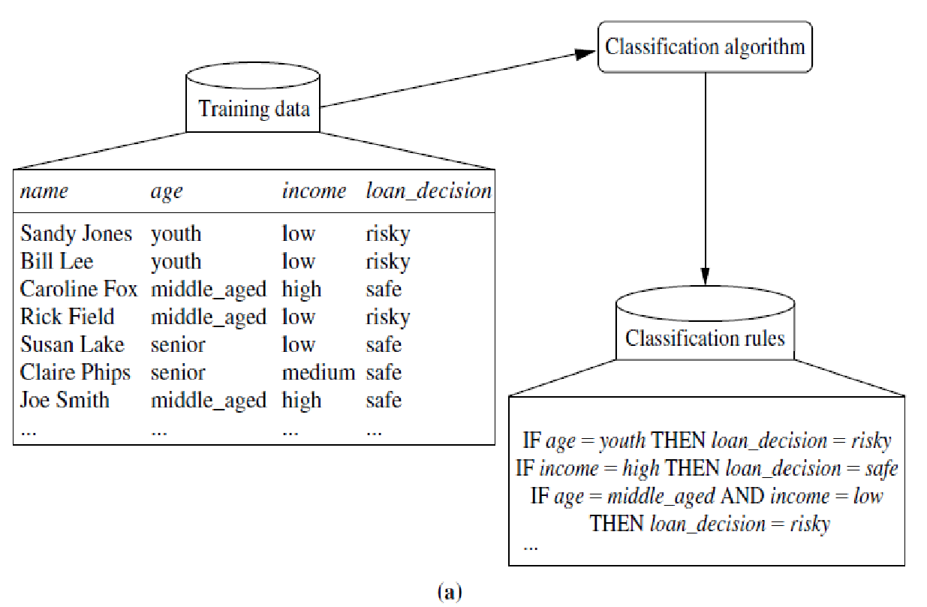
Data classification Process
Step 1:Learning Step
Y = f(X)
Y: Class label
X=Given tuple
The data classification process: (a) Learning step:Training data are analyzed by a classification algorithm.
Here, the class label attribute is loan decision, and the learned model or classifier is represented in the form of classification rules.
‹#›

Slide 7
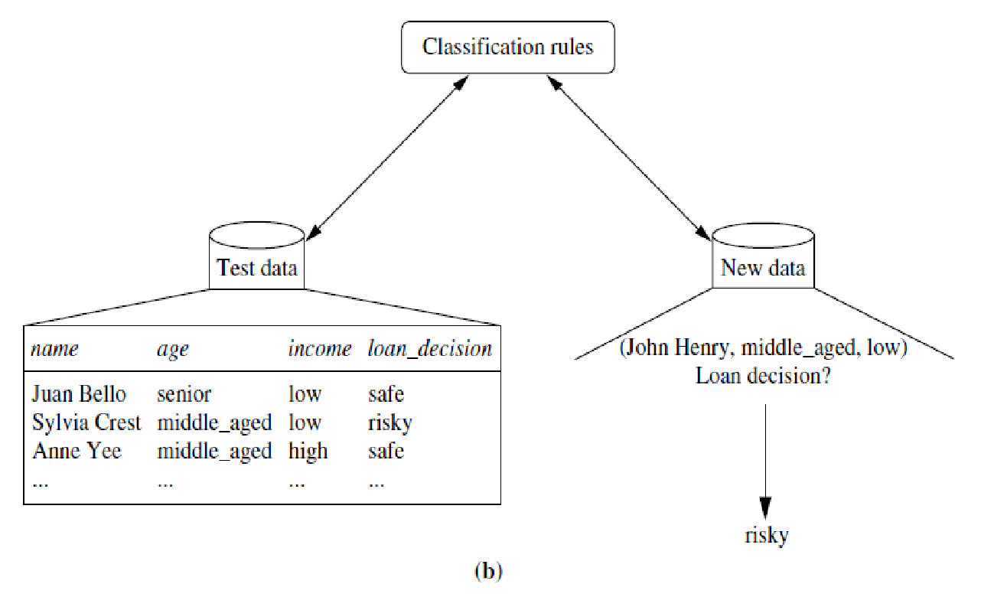
Data Classification Process
Step 2:Classification Step
(b) Classification step : Test data are used to estimate the accuracy of the classification rules. If the accuracy is considered acceptable, the rules can be applied to the classification of new data tuples.
The accuracy of classifier on a given test set is % of test set tuples that are correctly classified by classifier.
‹#›

Slide 8
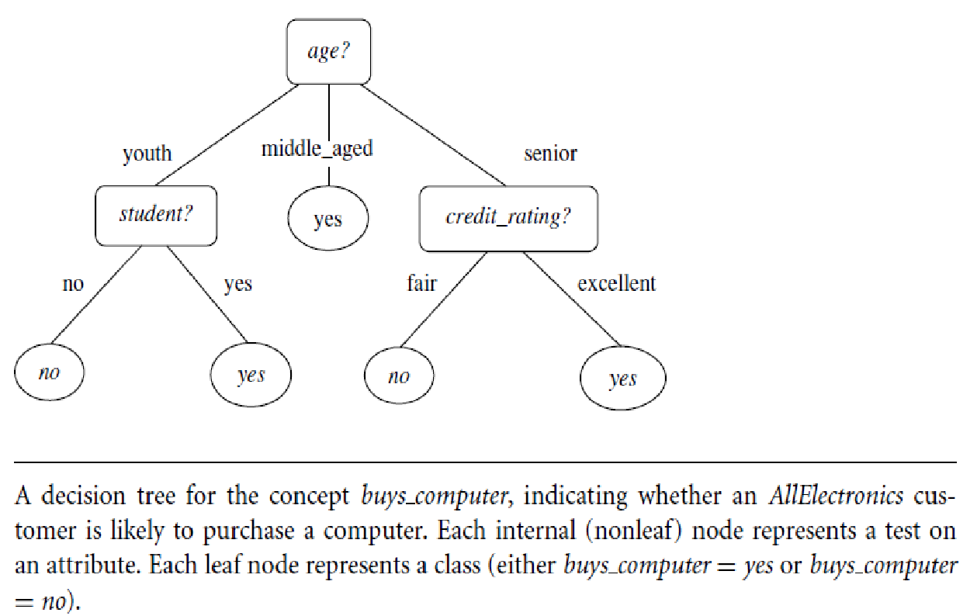
Decision Tree Induction
(Learning of a decision tree from class labeled training tuples)
‹#›

Slide 9
Decision Tree Induction
ID3 (Iterative Dichotomiser), C4.5, CART(Classification And Regression Trees) Algorithms.
These algorithms adopt a greedy (i.e., non backtracking) approach in which decision trees are constructed in a top-down recursive divide-and-conquer manner.
It starts with a training set of tuples and their associated class labels. The training set is recursively partitioned into smaller subsets as the tree is being built.
‹#›
Notes:
‹#›

Slide 10
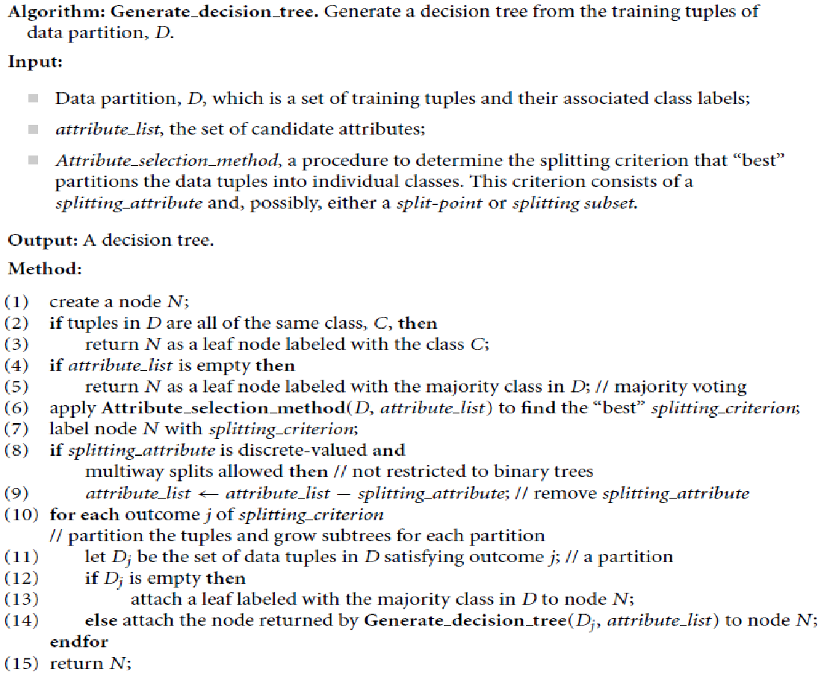
‹#›

Slide 11
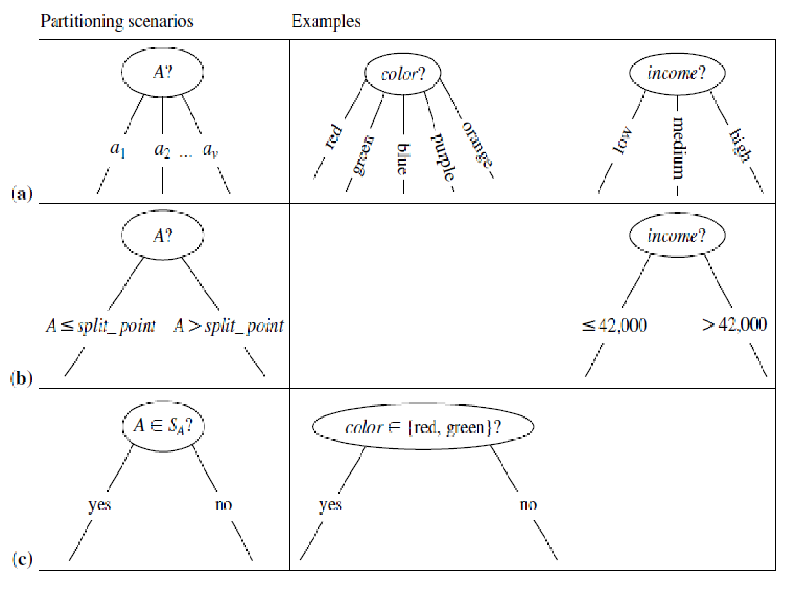
Let A be the splitting attribute. (a) If A is discrete-valued, then one branch is grown for each known value of A. (b) If A is continuous-valued, then two branches are grown, corresponding to A<= split point and A > split point.
(c) If A is discrete-valued and a binary tree must be produced, then the test is of the form
A ∈ SA?, where SA is the splitting subset for A.
Partitioning Scenarios
‹#›

Slide 12
Algorithm for Decision Tree Induction
The tree starts as a single node, N, representing the training tuples in D
If the tuples in D are all of the same class, then node N becomes a leaf and is labeled with that class.
Otherwise, the algorithm calls Attribute selection method to determine the splitting criterion.
The splitting criterion tells us which attribute to test at node N by determining the “best” way to separate or partition the tuples in D into individual classes.
The splitting criterion also tells us which branches to grow from node N with respect to the outcomes of the chosen test.
More specifically, the splitting criterion indicates the splitting attribute and may also indicate either a split-point or a splitting subset.
The splitting criterion is determined so that, ideally, the resulting partitions at each branch are as “pure” as possible.
A partition is pure if all the tuples in it belong to the same class.
‹#›

Slide 13
Algorithm for Decision Tree Induction
The node N is labeled with the splitting criterion, which serves as a test at the node. A branch is grown from node N for each of the outcomes of the splitting criterion. The tuples in D are partitioned accordingly.
The algorithm uses the same process recursively to form a decision tree for the tuples at each resulting partition, D_{j} , of D .
The recursive partitioning stops only when any one of the following terminating conditions is true:
All the tuples in partition D (represented at node N) belong to the same class.
There are no remaining attributes on which the tuples may be further partitioned.
In this case, majority voting is employed. This involves converting node N into a leaf and labeling it with the most common class in D. Alternatively, the class distribution of the node tuples may be stored.
There are no tuples for a given branch, that is, a partition D_{j} is empty.
In this case, a leaf is created with the majority class in D.
The resulting decision tree is returned.
‹#›

Slide 14
Attribute Selection Measures
(Also known as Splitting Rules)
An attribute selection measure is a heuristic for selecting the splitting criterion that “best” separates a given data partition, D , of class-labeled training tuples into individual classes.
The attribute selection measure provides a ranking for each attribute describing the given training tuples.
The three popular attribute selection measures—
information gain
gain ratio, and
Gini index
‹#›
Notes:
‹#›
This section describes
three popular attribute selection measures—information gain, gain ratio, and Gini index

Slide 15
Attribute Selection Measures: Information Gain (ID3 algorithm)
This measure is based on pioneering work by Claude Shannon on information theory, which studied the value or “information content” of messages.
The attribute with the highest information gain is chosen as the splitting attribute for node N.
This attribute minimizes the information needed to classify the tuples in the resulting partitions and reflects the least randomness or “impurity” in these partitions.
Such an approach minimizes the expected number of tests needed to classify a given tuple and guarantees that a simple (but not necessarily the simplest) tree is found.
‹#›
Notes:
‹#›
This section describes
three popular attribute selection measures—information gain, gain ratio, and Gini index

Slide 16
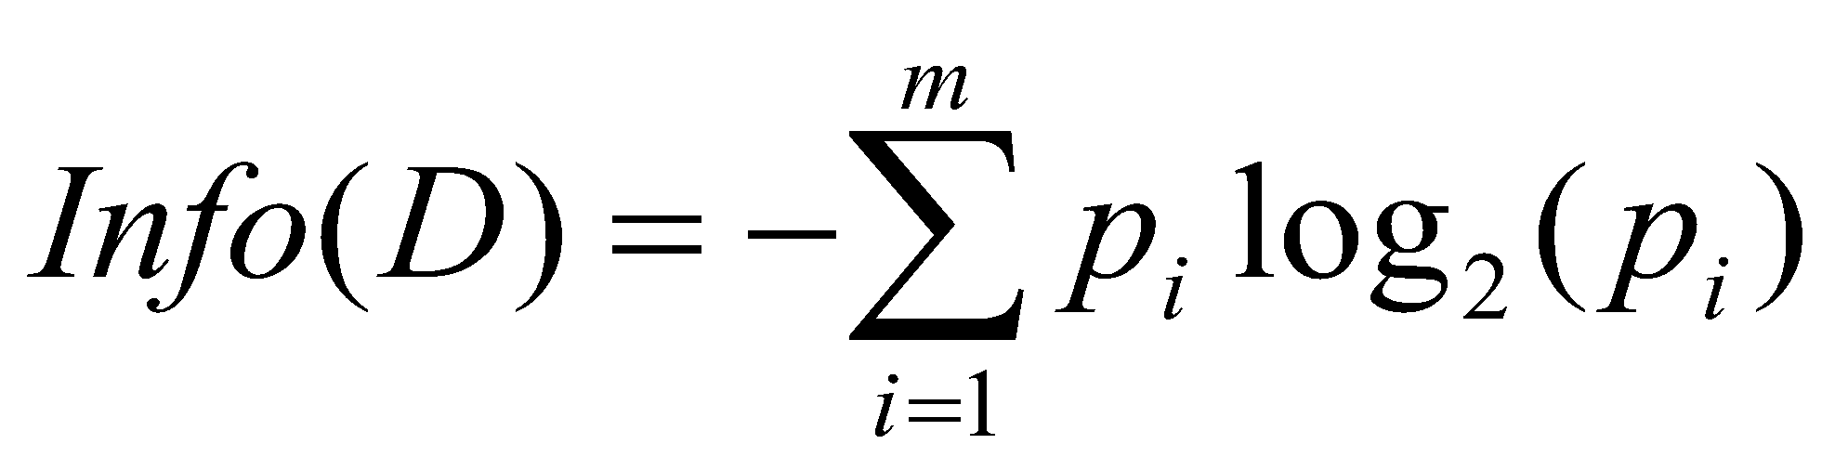
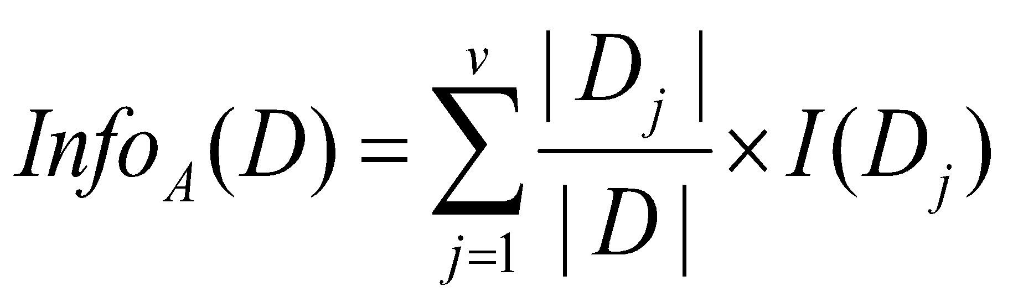
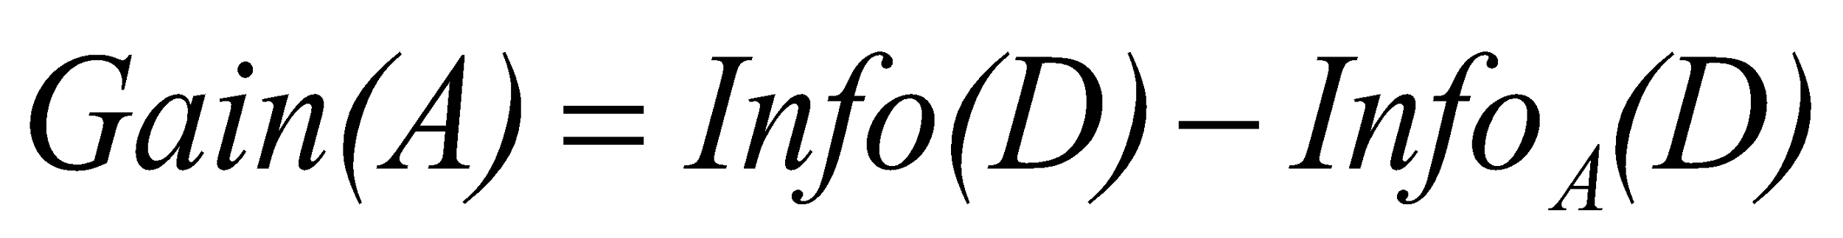
Attribute Selection Measure: Information Gain (ID3)
Select the attribute with the highest information gain.
Let p_{i} be the probability that an arbitrary tuple in D belongs to class C_{i} , estimated by |C_{i, D}|/|D|
Expected information (entropy) needed to classify a tuple in D:
Information needed (after using A to split D into v partitions) to classify D:
Information gained by branching on attribute A
Highest
Information
gain
‹#›
Notes:
‹#›
A log function to the base 2 is used, because the information is encoded in bits.
Info(D) is just the average amount of information needed to identify the class label of a tuple in D.
Info_{A}(D) is the expected information required to classify a tuple from D based on the partitioning by A. The smaller the expected information (still) required, the greater the purity of the partitions.
Gain(A) tells us how much would be gained by branching on A.
The attribute A with the highest information gain, Gain(A), is chosen as the splitting
attribute at node N.
I : the expected information needed to classify a given sample
E (entropy) : expected information based on the partitioning into subsets by A

Slide 17
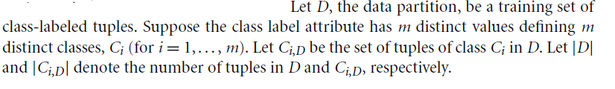
Information Gain (ID3)
Let p_{i} be the probability that an arbitrary tuple in D belongs to class C_{i} , estimated by
p_{i =}|C_{i, D}|/|D|
Expected information (entropy) needed to classify a tuple in D:
Information needed (after using A to split D into v partitions) to classify D:
Information gained by branching on attribute A
Select the attribute with the highest information gain.
‹#›

Slide 18
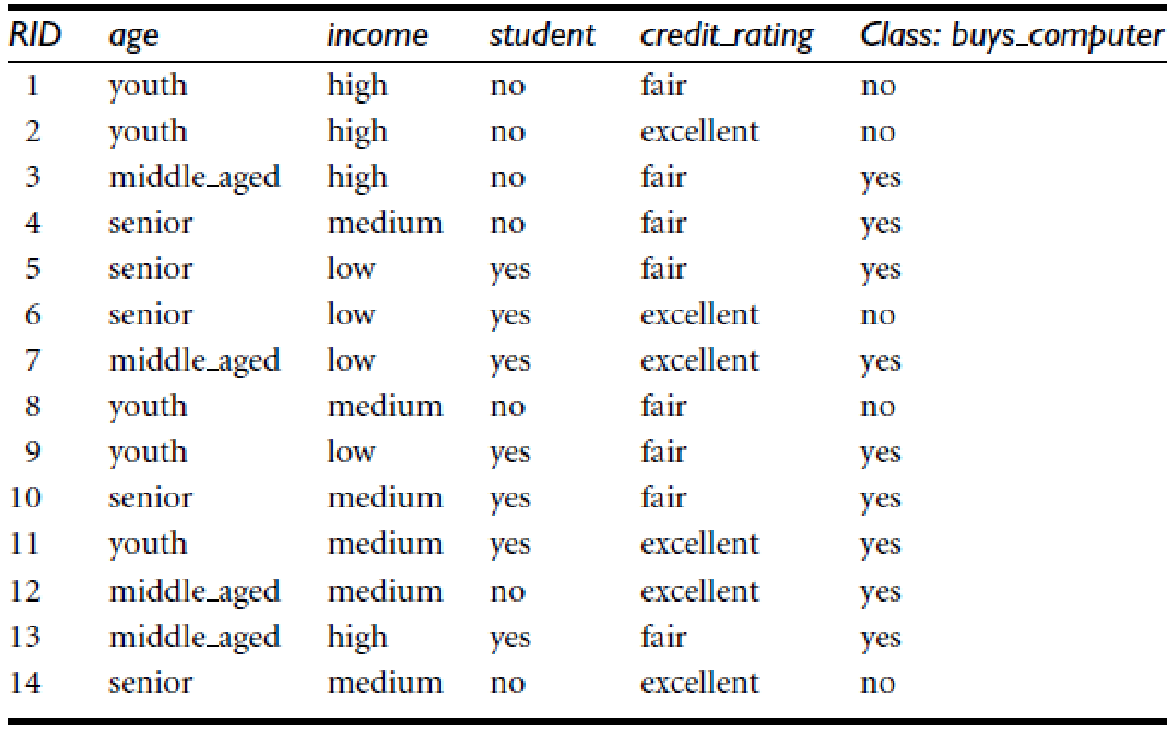
Example: Information Gain
‹#›

Slide 19
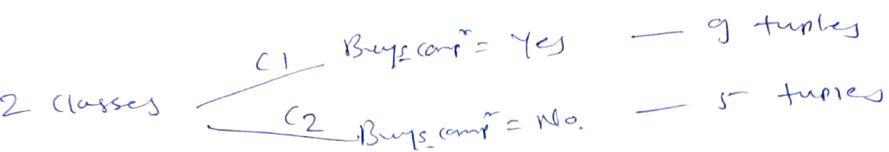

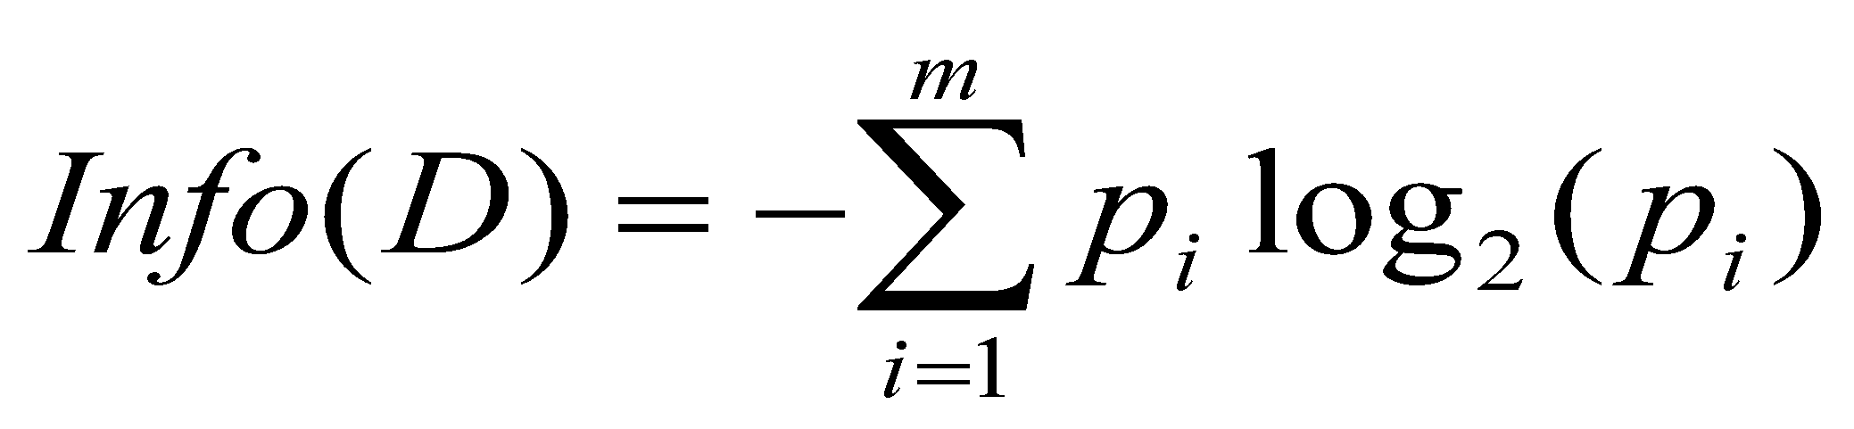
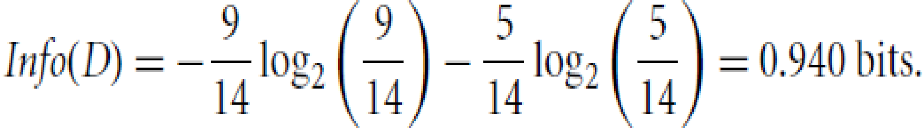
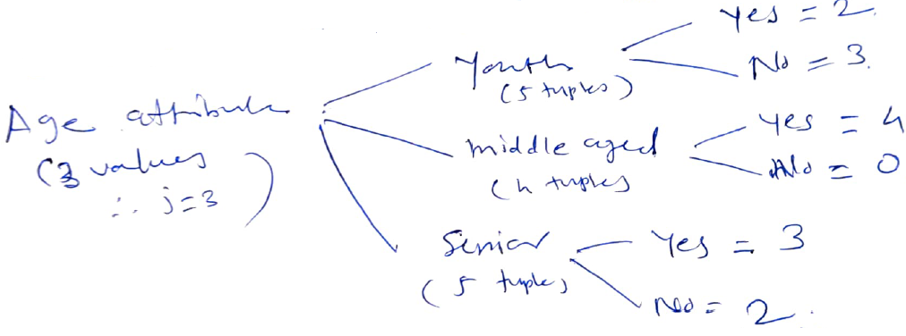
Example: Information Gain
‹#›

Slide 20
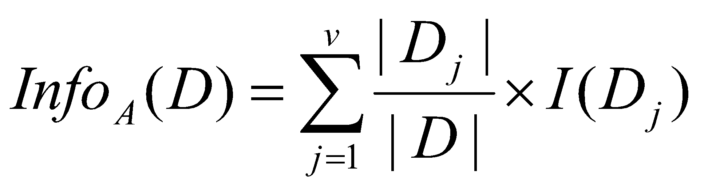
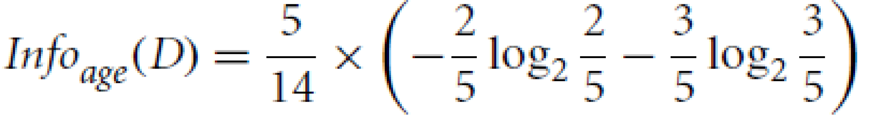


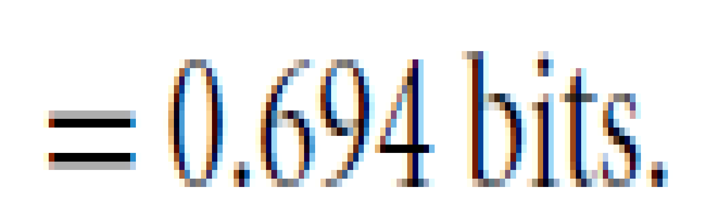

The expected information needed to classify a tuple in D if the tuples are partitioned according to age is:
Similarly, compute Gain(income) ,Gain(student) ,and Gain(credit rating)

Slide 21
Example: Information Gain(Cntd…)
we get Gain(income) = 0.029 bits, Gain(student) = 0.151 bits, and Gain(credit rating) = 0.048 bits.
Because age has the highest information gain among the attributes, it is selected as the splitting attribute.
Node N is labeled with age, and branches are grown for each of the attribute’s values.
‹#›
Notes:
‹#›

Slide 22
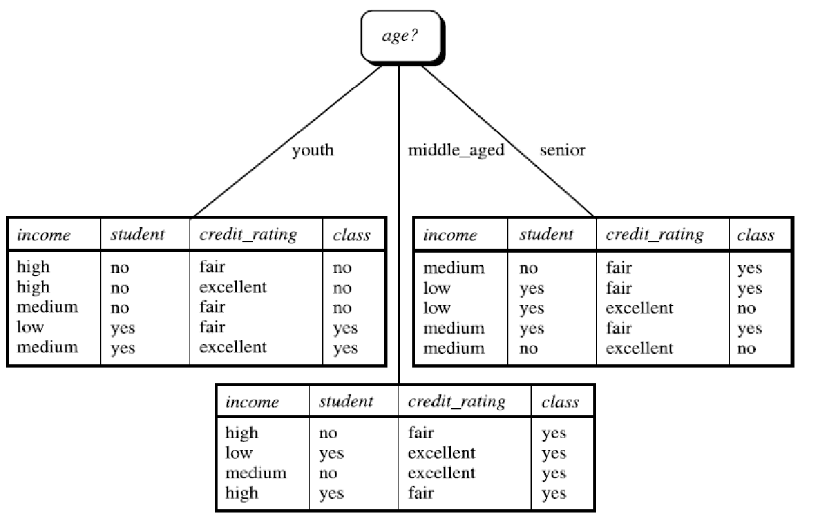
Notice that the tuples falling into the partition for age = middle_aged all belong to the same class.
Because they all belong to class “yes,” a leaf should therefore be created at the end of this branch and labeled “yes.”
‹#›

Slide 23
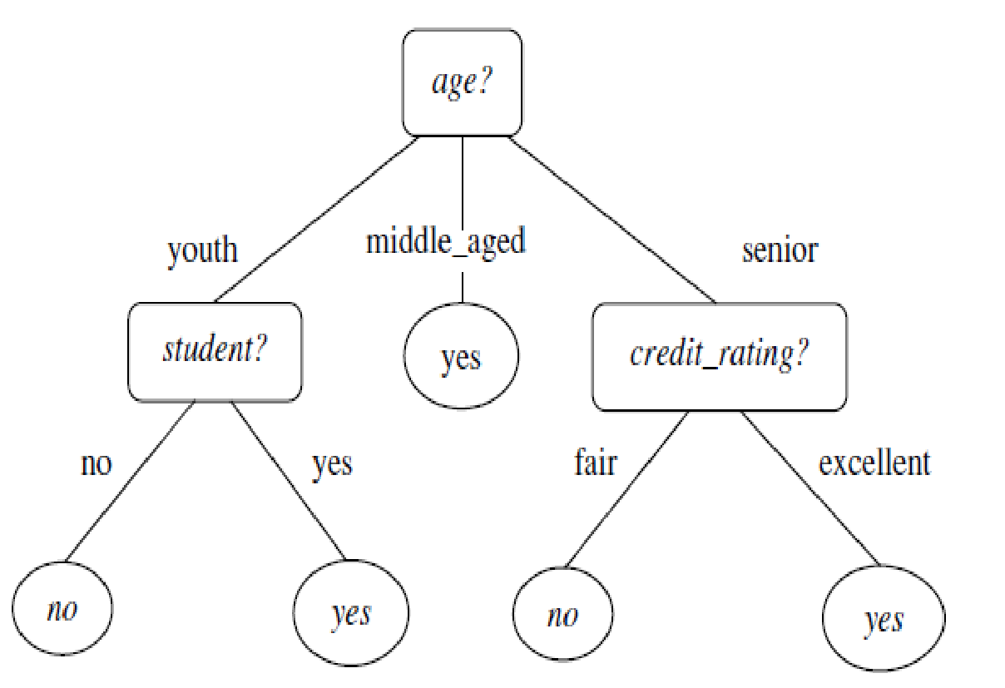
The final decision tree returned by the algorithm
‹#›

Slide 24
Using following training data set ,create decision tree classification model.
 | Income | Age | Own House?
1 | Very High | Young | Yes
2 | High | Medium | Yes
3 | Low | Young | Rented
4 | High | Medium | Yes
5 | Very High | Medium | Yes
6 | Medium | Young | Yes
7 | High | Old | Yes
8 | Medium | Medium | Rented
9 | Low | Medium | Rented
10 | Low | Old | Rented
11 | High | Young | Yes
12 | Medium | Old | Rented

Slide 25
Computing Information-Gain for Continuous-Value Attributes
Let attribute A be a continuous-valued attribute
Must determine the best split point for A
Sort the values of A in increasing order.
Typically, the midpoint between each pair of adjacent values where there is a change in classification is considered as a possible split point
(a_{i}+a_{i+1})/2 is the midpoint between the values of a_{i} and a_{i+1}
The point with the minimum expected information requirement for A is selected as the split-point for A
Split:
D1 is the set of tuples in D satisfying A ≤ split-point, and D2 is the set of tuples in D satisfying A > split-point
‹#›

Slide 26
Example: Computing Information-Gain for Continuous-Value Attributes
Step 1: Sort the values of A in increasing order.
Temp | Play Tennis?
40 | NO
48 | NO
60 | YES
72 | YES
80 | YES
90 | NO
Step 2: Determine the split points by averaging consecutive values where there is a change in classification.
So split points here are :
point 1= (48+60)/2=54 and
point 2 =( 80+90)/2= 85
Step 3: Evaluate the information gain of the candidate split points 54 and 85 and select the split point.
‹#›

Slide 27
Example: Computing Information-Gain for Continuous-Value Attributes
Entropy(D)=Info(D)=-(3/6) (log 3/6)- (3/6)(log (3/6) =1
Consider split point=54.
Temp | Play Tennis?
40 | NO
48 | NO
60 | YES
72 | YES
80 | YES
90 | NO
Temp <=54 : 2 tuples(Yes=0,No=2)
Temp>54 : 4 tuples(Yes=3,No=1)
Info Temp(D) =
Info Gain(Temp) =
0.54
1 - 0.54=0.46
Similarly for split point=85, calculate Info Gain(Temp) =
0.1908
As information gain for split point=54 is high, it will be selected.
‹#›

Slide 28
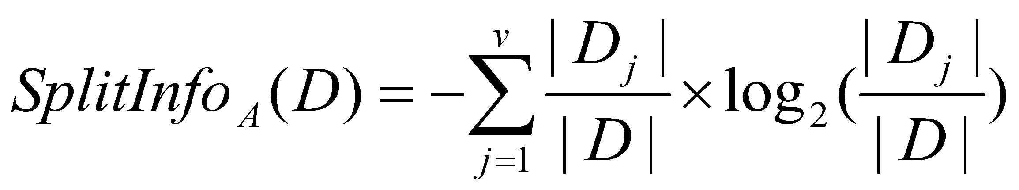
Gain Ratio for Attribute Selection (C4.5)
‘Information gain’ measure is biased towards attributes with a large number of values(e.g. Unique ID attribute like Product_ID)
C4.5 uses an extension to information gain known as gain ratio, which attempts to overcome this bias.
It applies a kind of normalization to information gain using a “split information” value defined analogously with Info(D) as
This value represents the potential information generated by splitting the training data set, D, into v partitions, corresponding to the v outcomes of a test on attribute A.
The gain ratio is defined as
GainRatio(A) = Gain(A)/SplitInfo_{A}(D)
The attribute with the maximum gain ratio is selected as the splitting attribute
‹#›

Slide 29
Example: Gain Ratio
Calculate Gain Ratio(Income)
‹#›

Slide 30
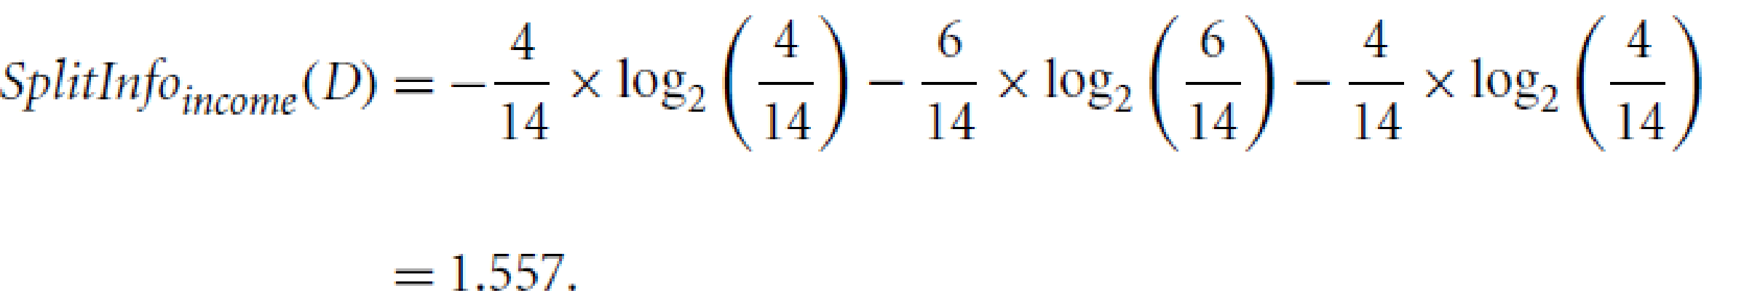
Example: Gain Ratio for income attribute
From previous example, Gain(income) = 0.029.
A test on income attribute splits the data of Table into three partitions, namely low, medium, and high, containing four, six, and four tuples, respectively.
GainRatio(income) = Gain(income)/SplitInfo_{income}(D)
Therefore, GainRatio(income) = 0.029 /1.557 = 0.019.
The attribute with the maximum gain ratio is selected as the splitting attribute
Drawback: tends to prefer unbalanced splits in which one partition is much smaller than the others.
‹#›

Slide 31
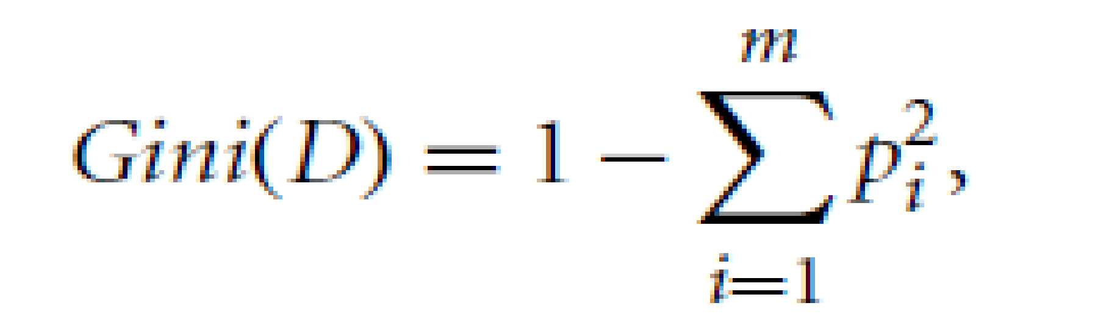
Gini index (CART)
Gini index measures the impurity of D, a data partition or set of training tuples, as
The Gini index considers a binary split for each attribute.
Case 1: A is discrete-valued: To determine the best binary split on discrete valued attribute A, we examine all the possible subsets of the known values of A.
Each subset, S_{A}, can be considered as a binary test for attribute A of the form “A Є S_{A}?”
If A has v possible values, then there are 2^{v} possible subsets.
Out of these, there are 2^{v} -2 possible ways to form two partitions of the data, D, based on a binary split on A.
‹#›

Slide 32
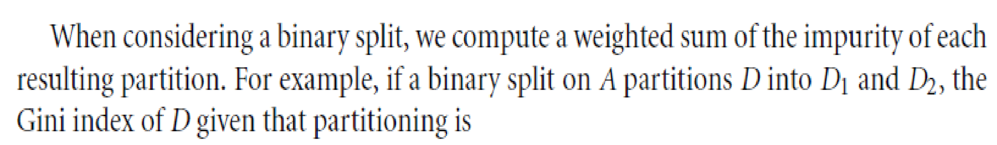
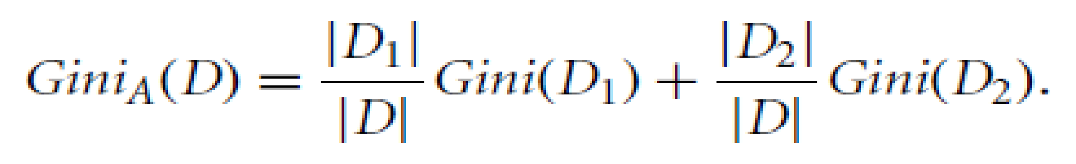
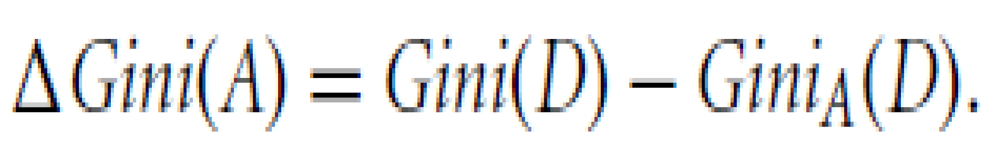
Gini index (CART)
For each attribute, each of the possible binary splits is considered.
For a discrete-valued attribute, the subset that gives the minimum Gini index for that attribute is selected as its splitting subset.
The reduction in impurity that would be incurred by a binary split on a discrete- or
continuous-valued attribute A is
The attribute that maximizes the reduction in impurity (or, equivalently, has the
minimum Gini index) is selected as the splitting attribute. This attribute and its splitting subset (for a discrete-valued splitting attribute) together form the splitting criterion.
‹#›

Slide 33
Gini index (Continuous-valued attribute)
For continuous-valued attributes, each possible split-point must be considered.
The strategy is to take the midpoint between each pair of (sorted) adjacent values as a possible split-point.
The point giving the minimum Gini index for a given (continuous-valued) attribute is taken as the split-point of that attribute.
Recall that for a possible split-point of A, D1 is the set of tuples in D satisfying A <= split point, and D2 is the set of tuples in D satisfying A > split point
The attribute that maximizes the reduction in impurity (or, equivalently, has the minimum Gini index) is selected as the splitting attribute. This attribute and its split-point (for a continuous-valued splitting attribute) together form the splitting criterion.
‹#›
Notes:
‹#›

Slide 34
Gini index (Continuous-valued attribute)
For continuous-valued attributes, each possible split-point must be considered.
The strategy is to take the midpoint between each pair of (sorted) adjacent values as a possible split-point.
The point giving the minimum Gini index for a given (continuous-valued) attribute is taken as the split-point of that attribute.
Recall that for a possible split-point of A, D1 is the set of tuples in D satisfying A <= split point, and D2 is the set of tuples in D satisfying A > split point
The attribute that maximizes the reduction in impurity (or, equivalently, has the minimum Gini index) is selected as the splitting attribute. This attribute and its split-point (for a continuous-valued splitting attribute) together form the splitting criterion.
‹#›
Notes:
‹#›

Slide 35
Example: Gini Index
‹#›

Slide 36
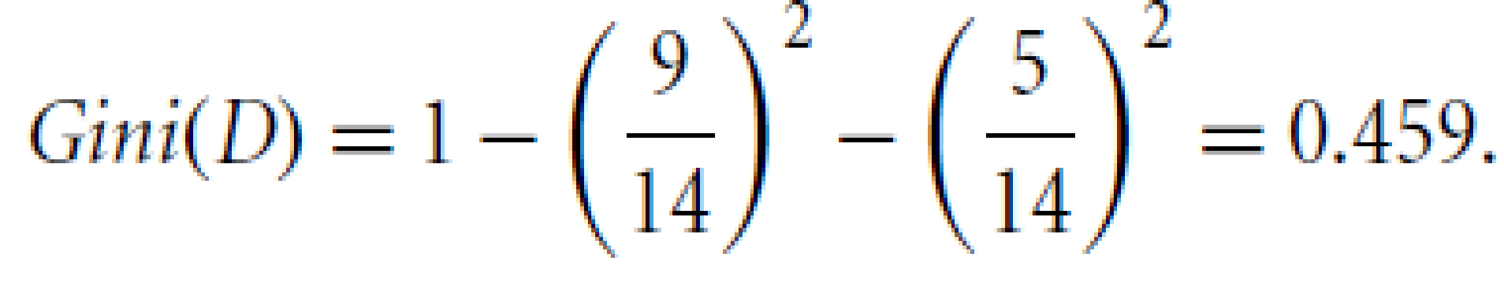
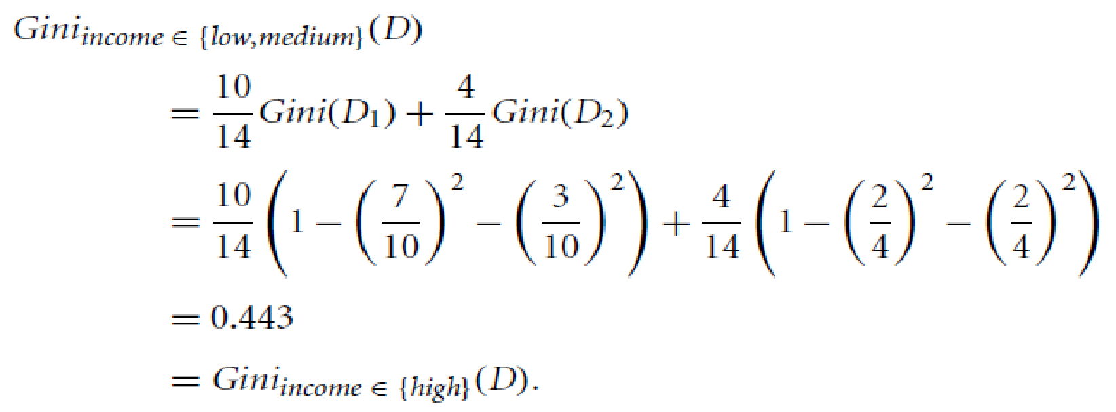
Example: Gini index
Ex: Let D be the training data where there are nine tuples belonging to the class buys computer = yes and the remaining five tuples belong to the class buys computer = no.
A (root) node N is created for the tuples in D. We first compute the impurity of D as:
To find the splitting criterion for the tuples in D, we need to compute the Gini index for each attribute.
Let’s start with the attribute income and and Consider the subset {low, medium}. This would result in 10 tuples in partition D₁ satisfying the condition “income Є {low, medium}.” The remaining four tuples of D would be assigned to partition D₂.
The Gini index value computed based on this partitioning is
0.458
Gini_{income Є (low,high}}^{(D) =}
0.450
Gini_{income Є (medium,high}}^{(D) =}
Therefore, the best binary split for attribute income is on {low, medium} or {high} because it minimizes the Gini index.
‹#›
Notes:
‹#›

Slide 37
Example: Gini index (Cntd…)
Evaluating age, we obtain Gini_{age Є (youth,senior}}^{(D)}=0.357 = Gini_{age Є (middle aged}}^{(D)}
The attributes student and credit rating are both binary, with Gini index values of 0.367 and 0.429, respectively.
The attribute age and splitting subset {youth, senior} therefore give the minimum Gini index overall, with a reduction in impurity of 0.459 - 0.357 = 0.102. The binary split “age Є {youth, senior?}” results in the maximum reduction in impurity of the tuples in D and is returned as the splitting criterion.
Node N is labeled with the criterion, two branches are grown from it, and the tuples are partitioned accordingly.
‹#›
Notes:
‹#›

Slide 38
Comparing Attribute Selection Measures
Information gain:
biased towards multivalued attributes
Gain ratio:
tends to prefer unbalanced splits in which one partition is much smaller than the others
Gini index:
biased to multivalued attributes
has difficulty when # of classes is large.
tends to favor tests that result in equal-sized partitions and purity in both partitions
Although biased, these measures give reasonably good results in practice.
‹#›
Notes:
‹#›

Slide 39
Other Attribute selection measures
CHAID, a decision tree algorithm that is popular in marketing, uses an attribute selection measure that is based on the statistical x² test for independence.
C-SEP (which performs better than information gain and the Gini index in certain cases) and G-statistic (an information theoretic measure that is a close approximation to 2 distribution).
Attribute selection measures based on the Minimum Description Length (MDL) principle have the least bias toward multivalued attributes.
Other attribute selection measures consider multivariate splits (i.e., where the partitioning of tuples is based on a combination of attributes, rather than on a single attribute)
“Which attribute selection measure is the best?”
It has been shown that the time complexity of decision tree induction generally increases exponentially with tree height. Hence, measures that tend to produce shallower trees (e.g., with multiway rather than binary splits, and that favor more balanced splits) may be preferred.
However, some studies have found that shallow trees tend to have a large number of leaves and higher error rates.
Despite several comparative studies, no one attribute selection measure has been found to be significantly superior to others. Most measures give quite good results.

Slide 40
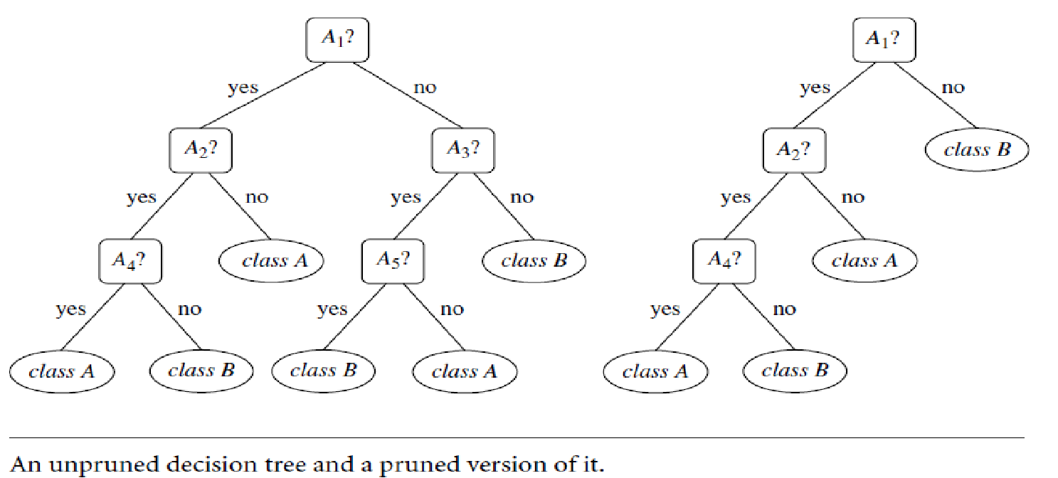
Overfitting and Tree Pruning
Overfitting:
When a decision tree is built, many of the branches will reflect anomalies in the training data due to noise or outliers.
Tree pruning methods address this problem of overfitting the data.
Such methods typically use statistical measures to remove the least-reliable branches.
‹#›
Notes:
‹#›

Slide 41
Overfitting and Tree Pruning
Two approaches to avoid overfitting : Prepruning and Postpruning
Prepruning:
Halt tree construction early (e.g., by deciding not to further split or partition the subset of training tuples at a given node).
Upon halting, the node becomes a leaf.
The leaf may hold the most frequent class among the subset tuples or the probability distribution of those tuples.
Difficult to choose an appropriate threshold
Postpruning:
Remove branches from a “fully grown” tree—A subtree at a given node is pruned by removing its branches and replacing it with a leaf.
The leaf is labeled with the most frequent class among the subtree being replaced.
‹#›
Notes:
‹#›

Slide 42



